Slide 1
Data Analysis II Moderation & Mediation
Presented by
Evan E. Ozmat, MS
Notes:
Welcome everyone to the data analysis II seminar on moderation and mediation analysis.
These are powerful statistical techniques that help us understand complex and nuanced relationships between variables.
By the end of this session, you'll have a solid understanding of when and how to use these methods in your own research.

Slide 2

What You’ll Learn Today
Statistical methods for testing each approach
1
Data preparation & assumptions
2
Common pitfalls & how to avoid them
3
Practical examples and interpretation
4
Power Analysis
5
Notes:
Today’s seminar will cover these key topics.
We'll start with conceptual foundations for both moderation and mediation.
Then we'll dive into two types of each effect, statistical methods for testing each, proper data preparation, and key assumptions to satisfy.
We'll also discuss common pitfalls, walk through practical examples, and introduce you to running these analyses in SPSS using the PROCESS Macro and in Rstudio.
Lastly, if there is time, I’ll briefly discuss the importance of power analysis and conduct a power analysis in using G*Power, a free open-source program for power analysis.
As in previous seminars, I’m assuming a few things: First, that you’ve watched the videos I sent and that you’ve familiarized yourself with mediation and moderation broadly
And second, that you’ve already download the GitHub Repository. I’ve made edits since sending the email so if you downloaded it before today, you may want to re-download the repository now so that you can follow along if you’d like.
I’ll put the link to the repository in the chat:
https://github.com/EwokOzwok/Data-Analysis-II---CBHPAR-Seminar
If you don’t want to follow along, that’s fine. As before, I’ll upload the recording and add chapters to the video so you can follow along on your own, pause when you need to, and jump to chapters that are most relevant to your needs.

Slide 3
Introduction to Moderation
Definition: When the strength or direction of a relationship between two variables DEPENDS on a third variable (i.e., the moderator)
Key question(s):
When?
For whom?
Under what conditions?
Moderator (W)
Social Support (W)
Predictor (X)
Stress (X)
Outcome (Y)
Depression (Y)
Notes:
Let's start with moderation. A moderator is a variable that affects the strength or direction of the relationship between a predictor and an outcome. It essentially answers the question: "When" or "for whom" does X predict Y?
For example, the relationship between stress and depression might depend on the level of social support a person has. For those with high social support, stress might have minimal impact on depression, while for those with low social support, stress might significantly increase depression.
Notice in the diagram how the moderator Z affects the path between X and Y. This is typically tested statistically using interaction terms in regression models, which is simply multiplying the predictor (stress) by the moderator (Social Support).

Slide 4
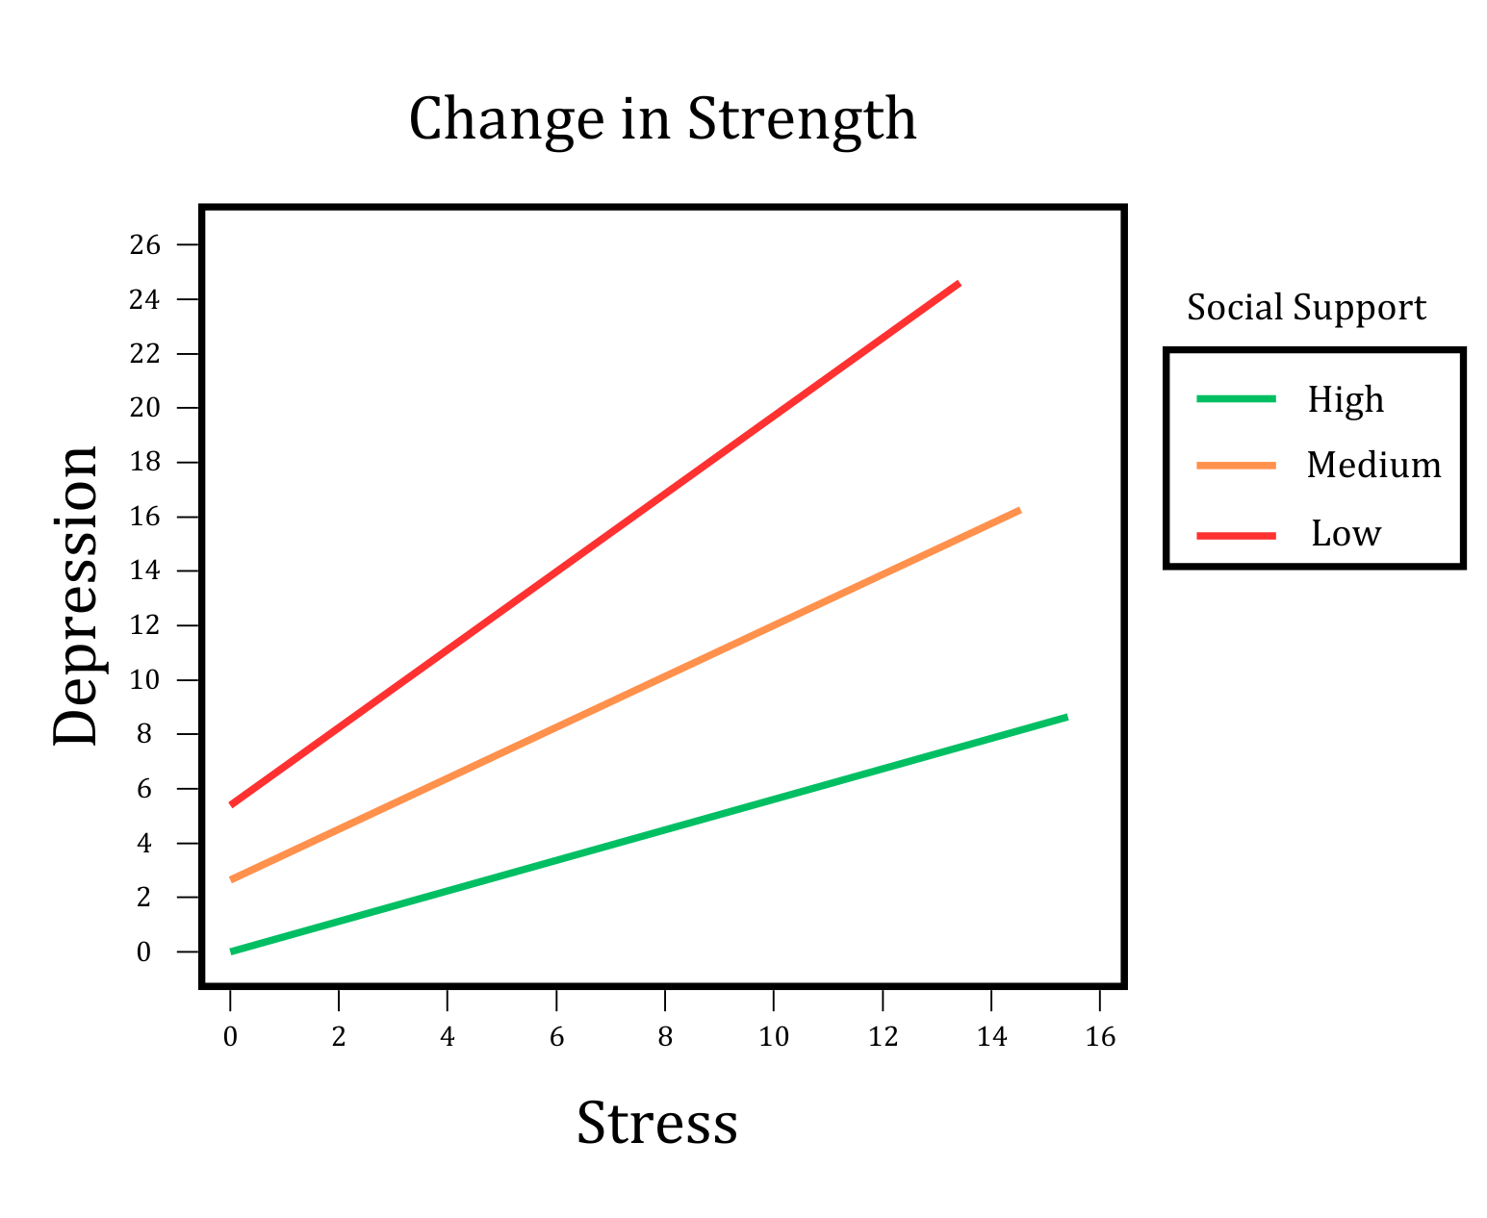
Moderation: Strength of X→Y Relationship
Social Support (W)
Stress (X)
Depression (Y)
Social support significantly moderates the link between stress and depression such that higher levels of social support attenuates (weakens) the link between stress and depression.
Notes:
First up, moderation of the STRENGTH of a relationship.
On the left side here, you see what is called an interaction plot. This is a Figure that should be included in any manuscript or poster that uses moderation.
When we have moderation of the strength of the relationship between X and Y the interaction plot may look something like this, where the slopes vary, but all go in the same direction. Using the previous example of social support moderating the relation between stress and depression, you’ll see the interpretation of this type of effect that you might write out in a manuscript or poster abstract in the lower right: “Social support significantly moderates the link between stress and depression such that higher levels of social support attenuates (weakens) the link between stress and depression.”
Visually interpreting the interaction plot we can see that when stress is low, the level of social support marginally influences depression (ranging from ‘normal’ to ‘mild’ depression on the PHQ-9) BUT when stress levels are high, the influence of social support on depression scores is more pronounced.

Slide 5
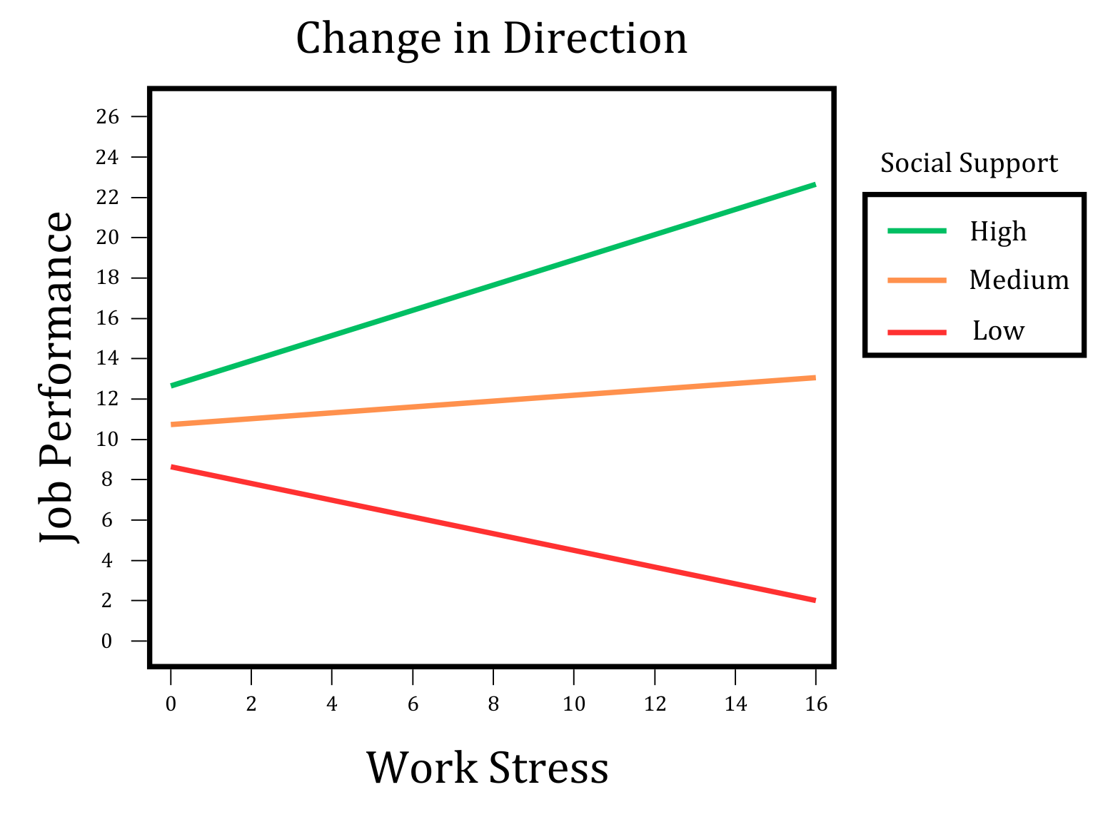
Moderation: Direction of X→Y Relationship
Social Support (W)
Work Stress (X)
Job Performance (Y)
Social support moderates the link between work stress and job performance such that for those with high social support, higher levels of work stress predicted improved job performance. Conversely, for those with low social support, increased work stress predicted decreased job performance.
Notes:
Second, lets look at moderation of the DIRECTION of a relationship.
Again, on the left side you’ll see the interaction plot for a moderation that changes the direction of the relationship between X and Y.
Here the slopes also vary, but now we see that some slopes are positive, and one slope is negative.
One real example of this type of moderation is the influence of social support on the relations between work stress and job performance.
In the lower right, again you’ll see the interpretation that you might include in a manuscript or poster abstract:
“Social support moderates the link between work stress and job performance such that for those with high social support, higher levels of work stress predicted improved job performance. Conversely, for those with low social support, increased work stress predicted decreased job performance.”
You may notice that in both interpretations we include additional information contextualizing the moderation effect after “such that…”. This type of information is critical, you must characterize the moderation effect fully!
When reporting moderation in manuscripts where you have more space to write, I recommend plugging extreme values of your predictor(s) into your regression equation and writing out what you find in narrative form.

Slide 6

Statistical Methods for Testing Moderation
Interaction term in regression models:
$Y= {β_{0}+ β}_{1}X_{1}+β_{2}W_{1}+β_{3}\left(X_{1}W_{1}\right)+ε$
Significant $β_{3}$ indicates significant moderation
Simple slopes analysis for interpretation
Continuous: M ± 1 SD
Categorical: Each level of the Moderator
Visualization using interaction plots
$$Work Perf.= {β_{0}+β}_{1}Work_Stress+β_{2}SocialSupport+β_{3}\left(Work_Stress∗Social Support\right)+ε$$
$$Depression= {β_{0}+β}_{1}Stress+β_{2}SocialSupport+β_{3}\left(Stress∗Social Support\right)+ε$$
Notes:
So, how do we test moderation statistically? Its pretty simple, we use multiplication. You specify an interaction term as the Predictor multiplied by the Moderator in your regression equation
And a statistically significant interaction effect (Beta 3) would indicate that the relationship between your predictor and outcome significantly depends on the level or value of your moderator.
The equation shown here includes our predictor X, our moderator Z, and their interaction term X×Z. If the coefficient b₃ for this interaction term is statistically significant, we have evidence of moderation.
After finding significant moderation, we typically conduct simple slopes analysis to interpret the effect.
This involves examining the relationship between X and Y at different levels of Z, typically at one standard deviation below the mean, at the mean, and one standard deviation above the mean of Z.
Interaction plots are extremely helpful for visualizing these relationships and making them accessible to your audience.

Slide 7
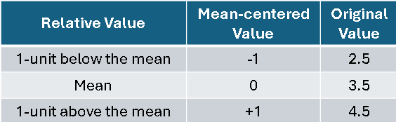
Data Preparation: Moderation Analysis
Mean-centering all predictors
Reduces multicollinearity between main effects and interaction
Makes interpretation more meaningful
Proper coding of categorical moderators
Reciprocal categories: Dummy coding (0,1)
Non-reciprocal: Effects coding (-1, 0, 1)
Additional Assumption for Moderation
Multivariate normality (Maximum Likelihood Estimation only)
Failed? Maximum Likelihood Estimation with Robust Standard Errors (MLR)
M_{PHQ9} = 3.5
Notes:
For moderation analysis, mean-centering your predictors is a key data preparation step.
This involves subtracting the mean value from each observation.
A quick example, If the mean PHQ-9 in your sample is 3.5, then after mean-centering… 0 will correspond to a PHQ-9 score of 3.5, the mean
1 will correspond to a score of 4.5, of one, unit above the mean
And -1 will correspond to a score of 2.5, one unit below the mean.
Mean-centering reduces multicollinearity between your main effects and the interaction term. It also makes the interpretation of your main effects and the intercept more meaningful –
After mean-centering the BETA 1 and BETA 2 coefficients represent the predicted effect for a participant at the sample mean of the other variable.
And the intercept represents the predicted level of your Outcome, say depression, for a participant whose stress and social support are at the mean of your sample.
CODING:
If your moderator is categorical, proper coding is essential. Consider using effect coding (-1, 0, 1) rather than dummy coding when appropriate.
ADDITIONAL ASSUMPTION:
In the interest of time, I will not be covering all of the assumptions that were covered in the last Data Seminar, you can refer to that video to familiarize yourself with the assumptions of multiple linear regression.
All of those assumptions must be satisfied to avoid reporting biased results.
Additionally, if you’re using ML estimation, you should satisfy the assumption of multivariate normality and use MLR if this assumption is failed. Now-a-days, it’s considered best practice to avoid ML estimation altogether and just use MLR.

Slide 8

Common Pitfalls in Moderation Analysis
Interpreting main effects without considering interactions
Not probing significant interactions
Mistaking statistical for practical significance
Overfitting with too many interaction terms
Failing to visualize interactions
Notes:
Now for the common pitfalls
In moderation analysis, a common mistake is interpreting main effects without considering significant interactions.
When an interaction is significant, the main effects must be interpreted in that context.
Not probing significant interactions through simple slopes analysis or Johnson-Neyman technique means missing important nuances in your data.
One easy way to probe an interaction effect is to visualize the effect. Without visualization, interpretation is difficult for both us and for readers, so always produce an interaction plot.
Be careful not to mistake statistical significance for practical significance - even significant interactions may have small effect sizes. This is where plugging the extreme values of your predictor and moderator into your regression equation can help a ton!
Finally, including too many interaction terms in your model can lead to overfitting and false positives. You should have clear theoretical justification for each interaction you test, which involves, as always, a thoughtful, in-depth review of the literature.

Slide 9
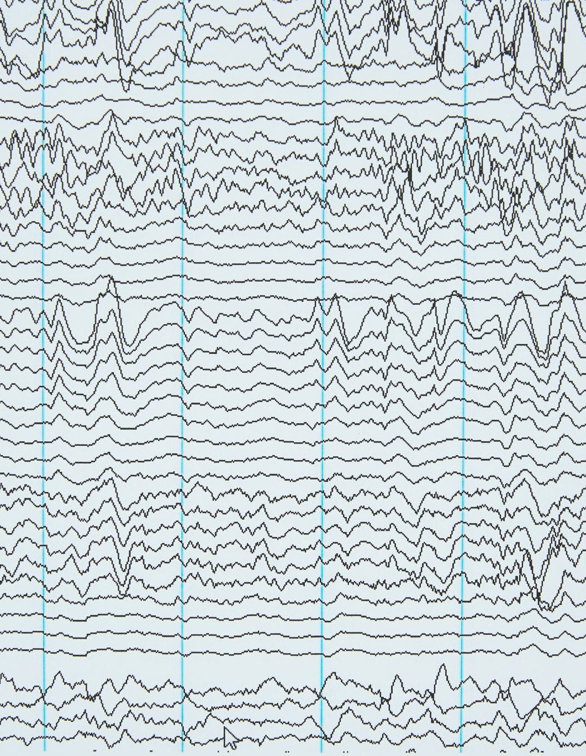
Moderation Example in R
File: 2 – Moderation.R
Data Cleaning & MLR Prep (lines 19-109)
Missing Data Analysis (lines 113-184)
Save Clean Data for Import into SPSS
Exploratory Data Analysis (lines 189-200)
Moderation
Nominal predictor & nominal moderator (lines 210 – 241)
Continuous predictor & nominal moderator (lines 247-278)
Continuous predictor & continuous moderator (lines 282-310)
Notes:
So now we’re going to jump into the Moderation example in R. We’ll start with R for data preparation and missing data analysis before running the analyses in R and SPSS, side-by-side. I’ll add into the chat screenshots of the R and SPSS slides so you can reference them as we go.
20-minutes in!

Slide 10

Moderation Example PROCESS Macro (SPSS)
File – Moderation Syntax.sps
Import data_clean.csv into SPSS
Data Cleaning (lines 1-34)
Exploratory Data Analysis (lines 37-60)
Moderation
Nominal predictor & nominal moderator (point & click)
Interaction Plot (lines 65-74)
Continuous predictor & nominal moderator (point & click)
Mean-centering & Interaction Plot (lines 80-100)
Continuous predictor & continuous moderator (point & click)
Mean-centering & Interaction Plot (lines 105-129)

Slide 11
Interpreting Coefficients
HINT!
Mean Flourishing = 0
Female = 0
$$Depression= {β_{0}+β}_{1}Flourishing+β_{2}GenderMale+β_{3}\left(Flourishing∗GenderMale\right)+ε$$
$$Depression=9.61−\left(3.45∗Flourishing\right)−(3.16∗GenderMale)+2.80\left(Flourishing∗GenderMale\right)$$
Predicted
Depression Score
for Females whose flourishing scores
are at the mean: (9.61)
Difference in predicted depression scores between males and females at mean flourishing: (-3.16)
Intercept for Males?
Predicted change in Females Depression for each 1-unit increase in Flourishing scores: (-3.45)
Difference in predicted depression scores between males and females for each 1-unit increase in Flourishing: (2.80)
(9.61)+
(-3.16) =
6.45
Predicted change in Male’s Depression for each 1-unit change in Flourishing scores???
(-3.45) +
(+2.80) =
-0.65
Notes:
For the intercept, we have to make everything except 9.61 equal to 0. Looking at our hint, that means the intercept is the predicted depression score for females at the mean of flourishing (9.61-between mild and moderate depression)
For Beta 1, -3.45, since Female = 0, this is the slope for females. For each 1-unit increase in females flourishing scores, there is a predicted 3.45 unit decrease in depression (rise over run)
What about the slope for males? We’ll get there at the end! Next up, Beta 2, -3.16. This tells us the Difference in predicted depression scores between males and females AT MEAN FLOURISHING (we have to zero out the other coefficients).
The coefficient 2.80 means that for each one-unit increase in mean-centered flourishing, the difference in PHQ-9 slope between males and females is 2.7971 points.
The positive interaction effect (2.80) indicates that for males, the negative association between Diener and PHQ-9 is reduced—meaning improvements in well-being may not translate as strongly to reductions in depression symptoms for males compared to females.

Slide 12
Plugging in
$$Depression= {β_{0}+β}_{1}Flourishing+β_{2}GenderMale+β_{3}\left(Flourishing∗GenderMale\right)+ε$$
$$Depression=9.61−\left(3.45∗Flourishing\right)−(3.16∗GenderMale)+2.80\left(Flourishing∗GenderMale\right)$$
Flourishing Level | MC-Value (Value) | Predicted Dep. (M) | Predicted Dep. (F)
Min | -4.32 (1) | 9.26 | 24.51
-1 SD | -1.15 (4.17) | 7.20 | 13.58
Mean | 0 (5.32) | 6.45 | 9.61
+1 SD | 1.15 (6.47) | 5.70 | 5.64
Max | 1.68 (7) | 5.36 | 3.81
Sample Min
$$Depression=9.61−\left(3.45∗−4.32\right)−(3.16∗1)+2.80\left(−4.32∗1\right)$$
Mean -1 SD
$$Depression=9.61−\left(3.45∗−1.15\right)−(3.16∗1)+2.80\left(−1.15∗1\right)$$
Mean
$$Depression=9.61−\left(3.45∗0\right)−(3.16∗1)+2.80\left(0∗1\right)$$
Mean +1 SD
$$Depression=9.61−\left(3.45∗1.15\right)−(3.16∗1)+2.80\left(1.15∗1\right)$$
Sample Max
$$Depression=9.61−\left(3.45∗1.68\right)−(3.16∗1)+2.80\left(1.68∗1\right)$$
GenderMale | 0 = Female (58%) 1 = Male (42%)
Flourishing | Ranges from 1-8 (1-7 in sample) M = 5.32; SD = 1.15
Depression | Ranges from 0-27 (0-22 in sample) M = 7.98; SD = 5.5
Notes:
The coefficient 2.80 means that for each one-unit increase in mean-centered flourishing, the difference in PHQ-9 slope between males and females is 2.7971 points.
The positive interaction effect (2.80) indicates that for males, the negative association between Diener and PHQ-9 is reduced—meaning improvements in well-being may not translate as strongly to reductions in depression symptoms for males compared to females.
END MODERATION AT 20 MIN + 40 MIN = 60 min.

Slide 13
Introduction to Mediation
Definition: When a predictor’s effect on the outcome occurs either fully or partially THROUGH a 3rd variable (i.e., the mediator)
Key question:
How?
Through what mechanism?
Direct Effect = c’
Indirect Effect = a*b
Total Effect = c = (a*b) + c’
Sleep Quality (M)
a
b
c
Social Media Use (X)
Academic Performance (Y)
c’
Notes:
Mediation, on the other hand, helps us understand "how" or "why" one variable affects another. A mediator is the mechanism through which an independent variable influences a dependent variable.

Slide 14
Full Mediation
Indirect Effect (a*b) is significant AND
Direct Effect (c’) is non-sig. when M is added
Sleep Quality (M)
a*
b*
Social Media Use (X)
Academic Performance (Y)
c’
Notes:
Full Mediation: The indirect effect (a×b) is significant, and the direct effect c′ (the effect of X on Y after controlling for M) is no longer significant when the mediator is included. This suggests that the relationship between X and Y is entirely explained by M.

Slide 15
Partial Mediation
Indirect Effect (a*b) is significant BUT
Direct Effect (c’) is still significant when M is added
Sleep Quality (M)
a*
b*
Social Media Use (X)
Academic Performance (Y)
c’*
Notes:
Partial Mediation: The indirect effect (a×b) is significant, but the direct effect c′ remains significant even after M is included. This indicates that M explains part of the relationship between X and Y, but there is still a direct effect of X on Y that is not fully accounted for by M.

Slide 16
Statistical Methods for Testing Mediation
Historical Approach(es)
Baron & Kenny's causal steps
Sobel’s Test
Modern approaches: Bootstrapping indirect effects
Process MACRO (SPSS)
Structural Equation Modeling (SEM) using lavaan (RStudio)
Notes:
For mediation, the traditional approach was Baron and Kenny's causal steps. However, modern approaches focus on testing the significance of the indirect effect.
Baron & Kenny’s Causal Steps Approach (1986)
Method: This approach requires four steps:
Path c: Show that the IV significantly predicts the DV.
Path a: Show that the IV significantly predicts the mediator.
Path b: Show that the mediator significantly predicts the DV while controlling for IV.
Path c': Show that the direct effect (c') is reduced when the mediator is included (partial mediation) or becomes non-significant (full mediation).
Conceptual Issues:
Does not actually test the indirect effect (a × b), which is the key component of mediation.
Ignores indirect effects even when c is non-significant, whereas modern mediation methods allow for significant mediation without a total effect.
Misclassifies partial and full mediation by relying on significance testing rather than effect size.
The Sobel test assumes the indirect effect follows a normal distribution, which is often violated.
The Sobel test directly tests the a × b path using a normal approximation formula:
Sobel’s test only provides a Z-score and p-value, but modern mediation analysis (e.g., PROCESS macro) uses bootstrapped confidence intervals to give more informative results.
Assumes that the sampling distribution of the indirect effect (a × b) is normally distributed, but in reality, it is often skewed, especially in small samples.
Bootstrapping does not require this assumption and is more robust.
Bootstrapping is the modern gold standard for testing mediation. Unlike older methods like Baron & Kenny’s steps or the Sobel test, it does not assume normality of the indirect effect.
Here’s how it works:
The indirect effect (a × b) is repeatedly recalculated using thousands of resampled datasets (e.g., 5,000 iterations).
This generates a distribution of indirect effects from the data, rather than relying on a single estimate.
A confidence interval (CI) is created—if the interval does not include zero, mediation is considered significant.
Bootstrapping is more accurate, more powerful, and works well even with small samples. It’s used in PROCESS for SPSS and is now the preferred method for mediation analysis.

Slide 17
Data Preparation for Mediation Analysis
MLR Assumptions must be satisfied!
Critical Mediation Assumptions
Temporal precedence:
X must precede M which should precede Y
At the very least, X should proceed both M and Y
No Multicollinearity
Prevents suppression effects
No Influential Outliers
Adequate Power (required sample size?)
Notes:
Proper data preparation is crucial for valid mediation analysis. First, temporal precedence is essential - your independent variable must precede your mediator, which must precede your outcome. This is ideally established through research design, such as longitudinal studies.
Multicollinearity between your predictor and mediator can lead to suppression effects, which can bias your results. Check correlations and variance inflation factors.
Sample size is also important - mediation analyses typically require larger samples than direct effect tests. As a rule of thumb, aim for at least 100-150 participants, though more complex models may require more.
The assumption of normal distribution of indirect effects is often violated, which is why bootstrapping methods are preferred.
You should always check for outliers and influential cases that might be biasing your results.
Lastly, you should ensure you check to see if your sample size is the large enough to afford you the statistical power you need to be confident that your results are valid! If we have time at the end, I’ll go over statistical power. Otherwise, I’ll add it as a chapter to the end of the video before uploading on YouTube.

Slide 18

Common Pitfalls in Mediation Analysis
Assuming causality from cross-sectional data
Omitted variable bias
Reversed causality
Confounding mediator-outcome relationship
Failing to investigate suppression
Ignoring measurement error
Using p-values to infer statistical significance
Notes:
There are several common pitfalls in mediation analysis that researchers should be aware of.
First, many researchers mistakenly infer causality from cross-sectional data. Remember that true mediation implies a causal chain, which is best established through experimental or longitudinal designs.
Omitted variable bias occurs when you fail to include important variables that might explain the relationships you're observing.
Reversed causality is another issue - sometimes what you think is Y might actually be causing X (temporal precedence helps a lot with this).
In mediation models, third variables (confounders) can distort the mediator-outcome relationship, leading to spurious effects. For example, if a confounder influences both the mediator and the outcome, it can create the illusion that the mediator is responsible for the relationship, when it's actually the confounder at play. To avoid this, control for potential confounders, use longitudinal or experimental designs to establish causality, and perform sensitivity analyses to confirm the robustness of your findings.
Another is failing to investigate suppression. The most problematic forms of suppression occur when the direct effect has a different sign (i.e., positive vs. negative) compared to the indirect effect or total effect. The example we’ll do today has non-problematic suppression, so I’ll take you through the steps needed to investigate suppression.
Finally, measurement error in your variables can attenuate your observed relationships and lead to biased estimates of mediation effects, so you need to make sure that the instruments you are using adequately measure the construct in your sample (literature review and/or CFA).

Slide 19
Why not p-values in Mediation? Bootstrapped Coefficients
Non-normal Indirect Effect (i.e., mediation path)
A product of two coefficients (a × b)
Rarely normally distributed!
Why Not p-Values?
Assumes normality and a large sample size
Violated assumptions → biased inferences
Methods for Bootstrapped Confidence Intervals (CIs)
Delta Method (lavaan default): Taylor series approximations for standard errors and relies on normality assumptions :/
Non-Parametric Bootstrapping: Resamples data to empirically derive confidence intervals (available in R and default on PROCESS Macro)
A p-value might suggest non-significance, but if the bootstrapped CI does not cross 0, the effect is significant.

Slide 20
Mediation Example in R
File: 3 – Mediation.R
Data Cleaning & MLR Prep (lines 19-92)
Missing Data Analysis (lines 105-166)
Save Clean Data for Import into SPSS
Exploratory Data Analysis (lines 171-182)
Mediation
Mediation Data Preparation: (lines 217-221)
Specify and fit bootstrapped model using SEM (lines 228-257)
Examine bootstrapped results and plot mediation (lines 271-326)
Investigate Suppression (lines 330-378)
Notes:
So now we’re going to jump into the Moderation example in R. We’ll start with R for data preparation and missing data analysis before running the analyses in R and SPSS, side-by-side. I’ll add into the chat screenshots of the R and SPSS slides so you can reference them as we go.
20-minutes in!

Slide 21
Mediation Example PROCESS Macro (SPSS)
File – Mediation Syntax.sps
Import data_clean.csv into SPSS
Data Cleaning (lines 1-34)
Exploratory Data Analysis (lines 37-60)
Mediation
All point-and-click

Slide 22
Suppression
Identifying Suppression
Opposing Signs: Indirect effect (+) vs. Direct effect (-).
Strength of Effects: Direct effect is stronger (-) than the total effect.
When is Suppression Problematic?
Significance Change
If the direct effect is significant without a mediator but becomes non-significant with the mediator, suppression might bias results.
Multicollinearity Concerns
If the predictor and mediator are highly correlated, suppression might be an artifact.
Variance Inflation Factor (VIF) can help check this.
Testing for Problematic Suppression
See lines 330-378 of ‘3-Mediation.R’
Notes:
Suppression: When the direct and indirect effects have opposite signs, or the direct effect is stronger than the total effect.
Identification: We look for two key signs—opposite effect directions and a stronger direct effect than the total effect.
Problematic Suppression: If adding a mediator changes the significance of the direct effect or if high multicollinearity exists, results may be biased.
Model Fit: We check AIC; a better fit in the direct effect-only model suggests suppression may be distorting conclusions.
Final Thought: Suppression isn’t always problematic—it can reveal meaningful relationships. In our case, severe alcohol problems may heighten depressive symptoms, influencing how recent alcohol use appears to affect depression.

Slide 23
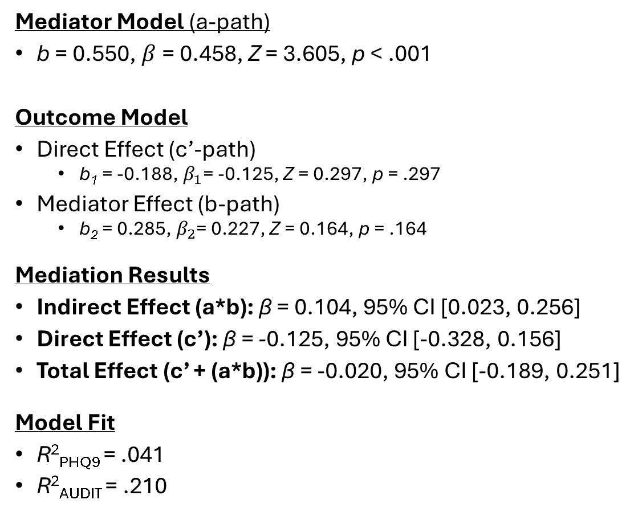

Reporting Mediation Results
$$AUDIT= {β_{0}+β}_{1}Alc30D+ε$$
Mediator Model (a-path)
b = 0.550, $β$= 0.458, Z = 3.605, p < .001
Outcome Model
Direct Effect (c’-path)
b₁ = -0.188, $β_{1}$= -0.125, Z = 0.297, p = .297
Mediator Effect (b-path)
b₂ = 0.285, $β_{2}$= 0.227, Z = 0.164, p = .164
Mediation Results
Indirect Effect (a*b): β = 0.104, 95% CI [0.023, 0.256]
Direct Effect (c’): β = -0.125, 95% CI [-0.328, 0.156]
Total Effect (c’ + (a*b)): β = -0.020, 95% CI [-0.189, 0.251]
Model Fit
R²_{PHQ9} = .041
R²_{AUDIT} = .210
$$Depression= {β_{0}+β}_{1}Alc30D+β_{2}AUDIT+ε$$
Figure 1
Mediation Model
AUDIT
-.458***
0.227
-0.020
Alc30D
Depression
-0.125
Notes:
This slide presents the results of our bootstrapped mediation analysis.
First, we examine the relationship between alcohol use in the past 30 days (Alc30D) and depression symptoms (phq9_total), testing whether alcohol-related problems (audit_total_mc) mediate this association.
The first equation (mediator model) shows that Alc30D significantly predicts audit_total_mc (p < .001), suggesting that increased alcohol use is associated with greater alcohol-related problems.
The second equation (outcome model) examines the effects of both alcohol use and alcohol-related problems on depression.
The direct effect of alcohol use on depression is not significant (p = .297).
The effect of alcohol-related problems on depression is also not significant (p = .164), meaning that audit_total_mc does not strongly predict depression in this model.
The mediation results show that the indirect effect (a × b) is 0.157 with a p-value of 0.077, which approaches significance. A 1-SD-unit increase in drinking days significantly predicts a 0.157 SD-unit increase in Depression scores THROUGH increased risky drinking behaviors (AUDIT).
This suggests a potential mediating role of alcohol-related problems in the relationship between alcohol use and depression but does not reach conventional statistical significance.
Since the total effect is non-significant (p = .855), this indicates that neither direct nor indirect effects contribute strongly to the overall variance in depression scores.
Lastly, the R² values indicate that alcohol use and alcohol-related problems explain 21% of the variance in audit_total_mc but only 4.1% of the variance in depression symptoms.
Overall, while there is some evidence of mediation, the effects are relatively weak and not statistically robust in this sample.

Slide 24

Power Analysis with G*Power
Download G*Power
Notes:
Let's discuss some tools you can use to implement these analyses. For SPSS users, Hayes' PROCESS macro is extremely popular and user-friendly.
R users have several options, including the lavaan package for SEM, the mediation package, and semTools.
Lastly, G*Power can help you conduct power analyses to determine appropriate sample sizes for your studies.

